Slide 1

Convolutional Neural Network (CNN)

Slide 2
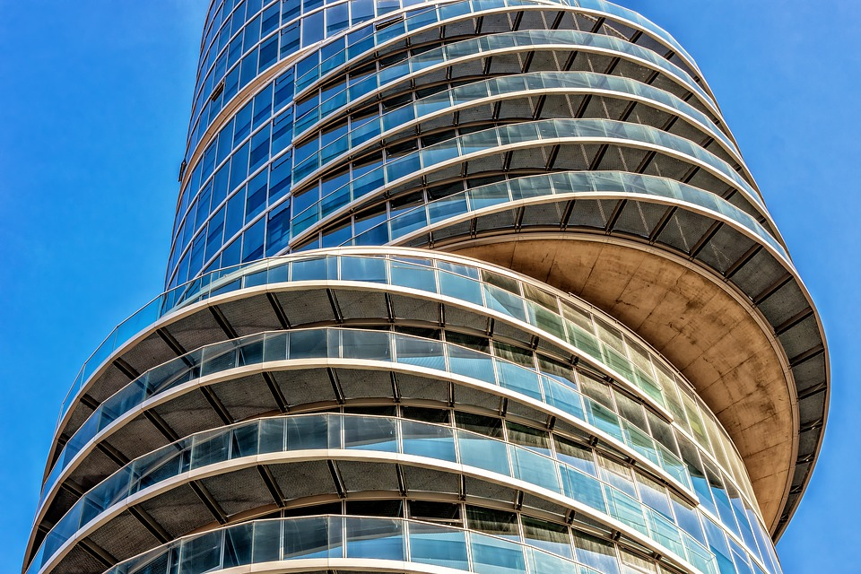
CNN Architectures

Slide 3
CNN Architecture Decisions
Number of Layers
Number of filters
Filter or Kernel Size
Pooling
Stride
Fully Connected Layers
Regularizers e.g. Batch Norm, Dropout

Slide 4

What are the Best Practices?
Review work in related domain and follow best practices..

Slide 5
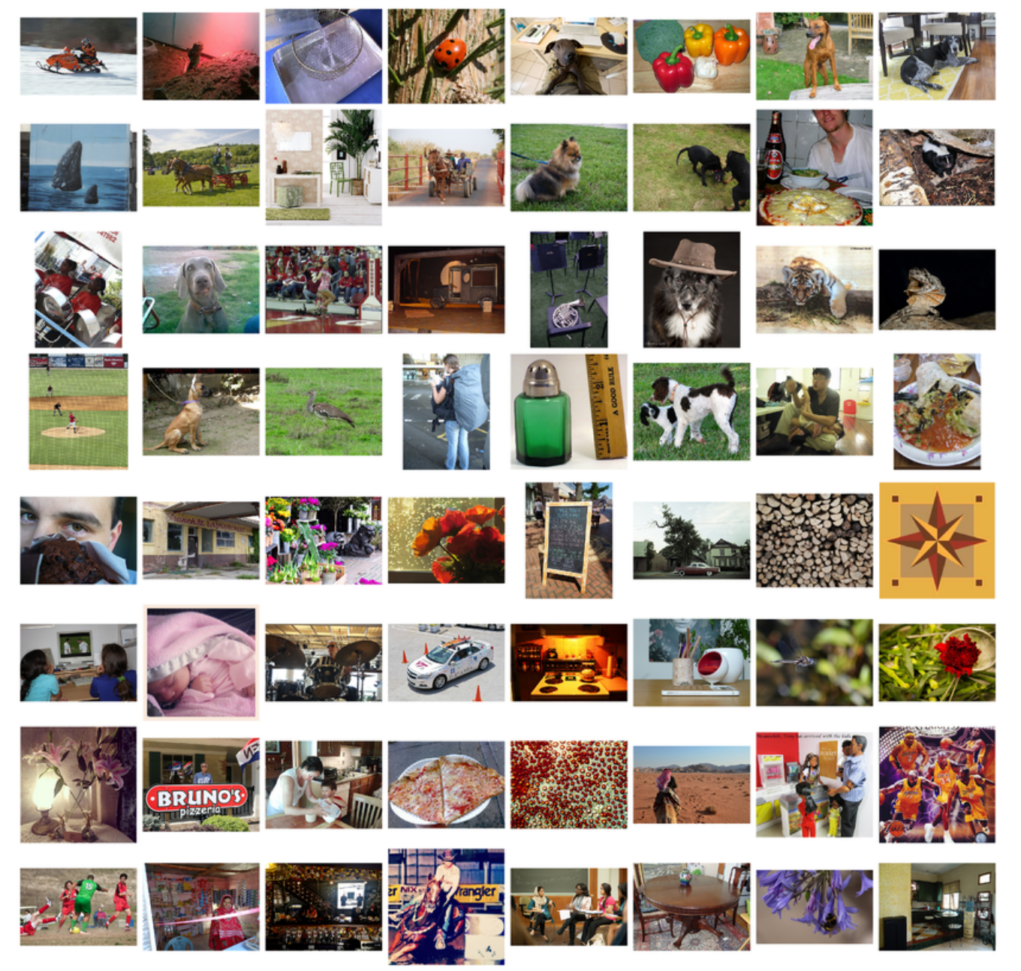
ILSVRC
(Imagenet Large Scale Visual Recognition Challenge)

Slide 6
What is ImageNet
Large Image Dataset
14+ Million images
~22K Categories
Human labeled
‘Describes’ the world around us
image-net.org

Slide 7
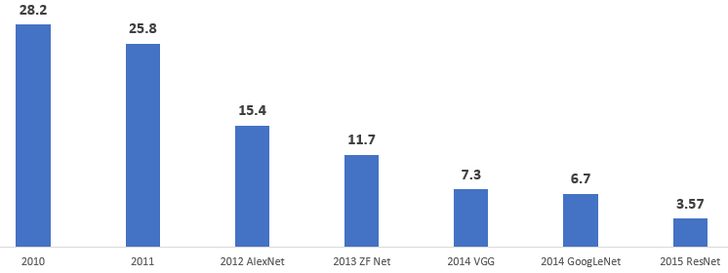
Top 5% Error Rate
CNN Based
Accuracy measured on test dataset for 1000 Categories

Slide 8
AlexNet (2012)
Reduced Error rate from 26% to 15%
A watershed moment in Computer Vision
Used a Deep Architecture
ReLU
Dropout
Data Augmentation
Inference Augmentation

Slide 9
AlexNet
SoftMax
FC 1000
FC 4096
5 Convolutional Layers
3 Max Pool Layers
3 Fully Connected Layers
GTX580 , 5-6 Days
FC 4096
Pool 3x3 S:2
Conv 256 3x3, S:1, P:1
Conv 384 3x3, S:1, P:1
Conv 384 3x3, S:1, P:1
Pool 3x3 S:2
Conv 256 5x5, S:1, P:2
Pool 3x3 S:2
Conv 96 11x11, S:4, P:0
Input 227x227x3

Slide 10
AlexNet
SoftMax
FC 1000
FC 4096
FC 4096
Input Image
227x227x3
Conv 1
96
11x11
Stride = 4
Overlapping Max Pool
3x3
Stride=2
Conv 2
256
5x5
Stride = 1
Padding = 2
Pool 3x3 S:2
?
?
?
Conv 256 3x3, S:1, P:1
Conv 384 3x3, S:1, P:1
Conv 384 3x3, S:1, P:1
Pool 3x3 S:2
Conv 256 5x5, S:1, P:2
Output size : (N - F + 2P)/s + 1
How many Weights to learn?
Pool 3x3 S:2
Conv 96 11x11, S:4, P:0
Input 227x227x3

Slide 11
Overlapping Max Pool
1 | 4 | 5 | 2 | 7
5 | 3 | 6 | 3 | 6
7 | 2 | 1 | 1 | 4
3 | 9 | 4 | 6 | 7
4 | 2 | 5 | 1 | 2
3 x 3 Filter
Stride 2

Slide 12
Overlapping Max Pool
1 | 4 | 5 | 2 | 7
5 | 3 | 6 | 3 | 6
7 | 2 | 1 | 1 | 4
3 | 9 | 4 | 6 | 7
4 | 2 | 5 | 1 | 2
3 x 3 Filter
Stride 2

Slide 13
AlexNet - Overlapping Max Pool
1 | 4 | 5 | 2 | 7
5 | 3 | 6 | 3 | 6
7 | 2 | 1 | 1 | 4
3 | 9 | 4 | 6 | 7
4 | 2 | 5 | 1 | 2
3 x 3 Filter
Stride 2

Slide 14
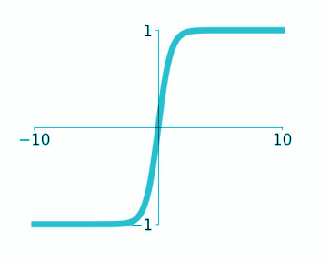
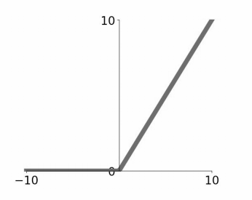
Relu vs tanh
hyperbolic tangent
max(0,x)
Relu helps with Vanishing Gradients issue

Slide 15
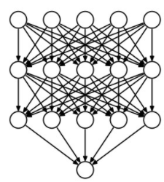
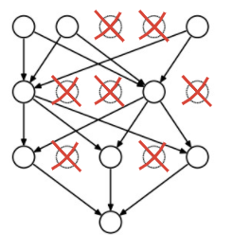
Dropout
Dropout applied with Fully connected Layers

Slide 16
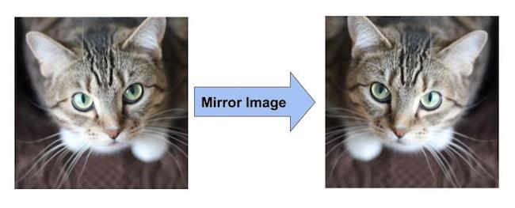
Data Augmentation
Horizontal Flip

Slide 17
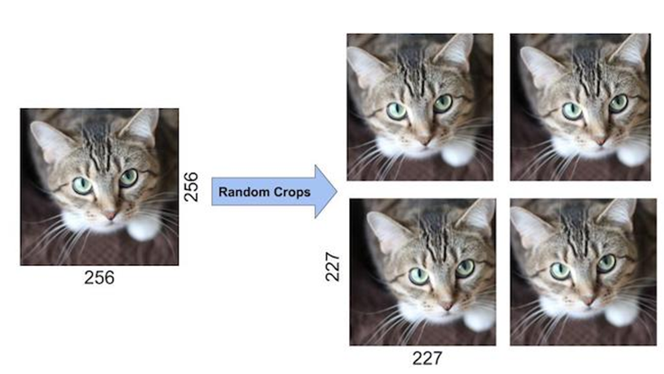
Data Augmentation
Random Crop

Slide 18
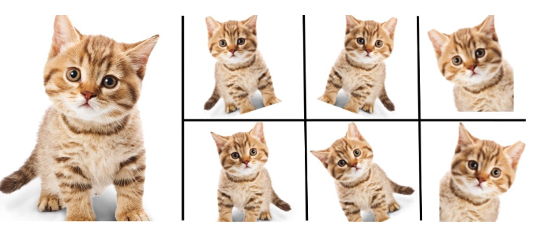
Inference Augmentation
Multiple Images for Prediction
Model
Average Output for Prediction
Prediction Time Augmentation

Slide 19
Summary - AlexNet (2012)
Deep Architecture with Convolutional Layers
Trained on ImageNet
Used ReLU instead of tanh
Dropout with FC Layers
Data Augmentation - Horizontal flips, Translations
Trained on GPU

Slide 20
Top 5% Error Rate
CNN Based
Accuracy measured on test dataset for 1000 Categories

Slide 21
ZF Net
SoftMax
FC 1000
FC 4096
Similar to AlexNet
Smaller filter size but more filters
GTX580 , 11-12 Days
Error rate of 11.7%
FC 4096
Pool 3x3 S:2
Conv 512 3x3, S:1
Conv 1024 3x3, S:1
Conv 512 3x3, S:1
Pool 3x3 S:2
Conv 256 3x3, S:1
Pool 3x3 S:2
Conv 96 7x7, S:2
Input 224x224x3

Slide 22
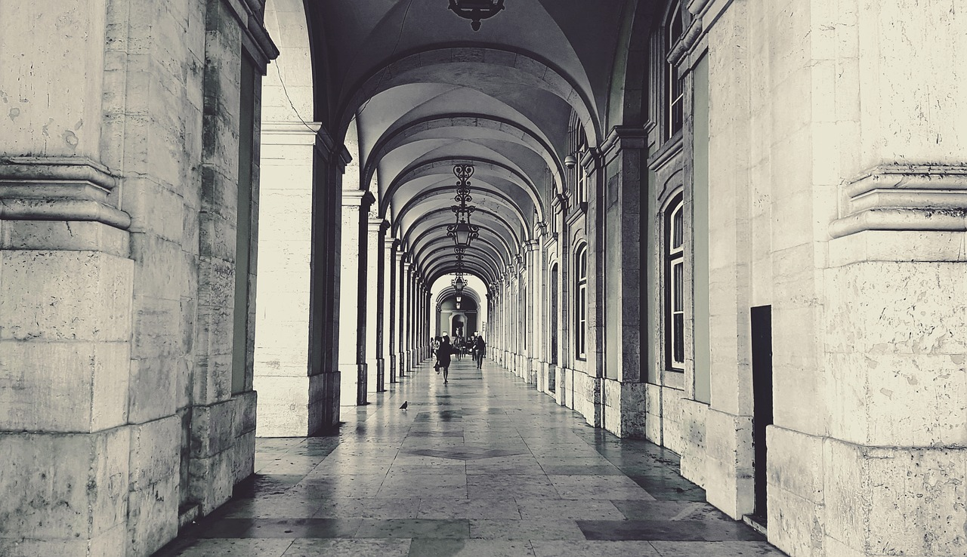
Building
Deeper Networks

Slide 23

VGG (2014)
researchgate.net

Slide 24
VGGNet
Input
Conv 3x3, 64
Conv 3x3, 64
Pool
Conv 3x3, 128
Conv 3x3, 128
Pool
Conv 3x3, 256
Conv 3x3, 256
Conv 3x3, 512
Pool
Conv 3x3, 512
Conv 3x3, 512
Conv 3x3, 512
Pool 3x3
Conv 3x3, 512
Conv 3x3, 512
Conv 3x3, 512
Pool 3x3
FC 4096
FC 4096
FC 1000
SoftMax
Very simple architecture
All Conv filters : 3x3 stride 1 pad 1
Max Pool : 2x2 stride 2
Nvidia Titan 2-3 Weeks
Error rate of 7.3%

Slide 25
What should be Filter Size?
3x3 Filter
5x5 Filter
7x7 Filter
Larger filters require more weights . . .

Slide 26

How do we use less weights but make it work like larger filters?
VGG provided a solution!

Slide 27
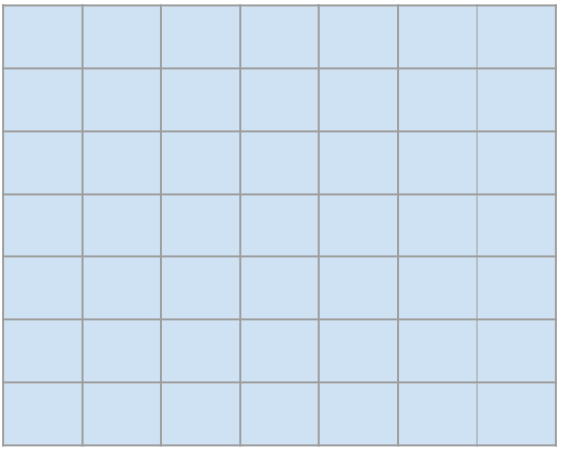
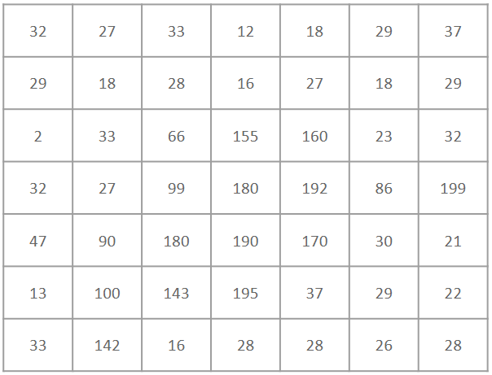
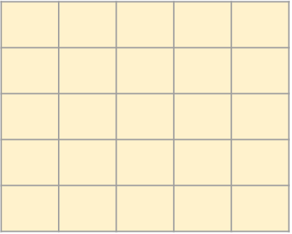
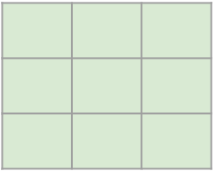
Understanding output for different filters sizes
Output size?
1 x 1
7x7 Filter
Output size?
3 x 3
5x5 Filter
7x7 Input image
Output size?
5 x 5
3x3 Filter

Slide 28

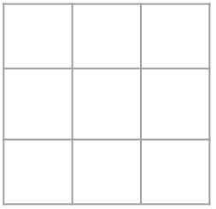
Two layers of 3x3 provide same output as one layer of 5x5
Relu
Relu
3x3 Filter
3x3 Filter
3x3 output
5x5 output
7x7 Input image
Weights using 3x3 filters with 2 layers = 18 (3x3x2)
Vs
Weights with 1 layer of 5x5 filter = 25 (5x5)

Slide 29
Two layers of 3x3 provide same output as one layer of 5x5
Relu
Relu
3x3 Filter
3x3 Filter
3x3 output
5x5 output
7x7 Input image
Additional non-linearity (Relu twice in 3x3 vs one in 5x5)

Slide 30

Three layers of 3x3 ... same output as one layer of 7x7
Relu
Relu
1x1 output
3x3 Filter
3x3 Filter
3x3 output
3x3 Filter
5x5 output
7x7 Input image
Weights using 3x3 filters with 3 layers = 27 (3x3x3)
Vs
Weights with 1 layer of 7x7 filter = 49 (7x7)

Slide 31
How many Parameters?
Input
30x30x64
Input
30x30x64
Conv 1
64, 3x3
S=1, Relu
Conv 1
64, 5x5,
S=1, Relu
Conv 1
64, 3x3, S=1, Relu
Reduces Model Size
3x3x64xx64 + 3x3x64x64
= 18x64x64
5x5x64xx64
= 25x64x64

Slide 32
Increasing Filters with Depth
Initial layers capture low level information e.g edges etc
Later layers combine initial features to learn for higher level info
researchgate.net

Slide 33
Ensembles
Model # 1
Model # 2
Average of Multiple Predictions
Model # n

Slide 34
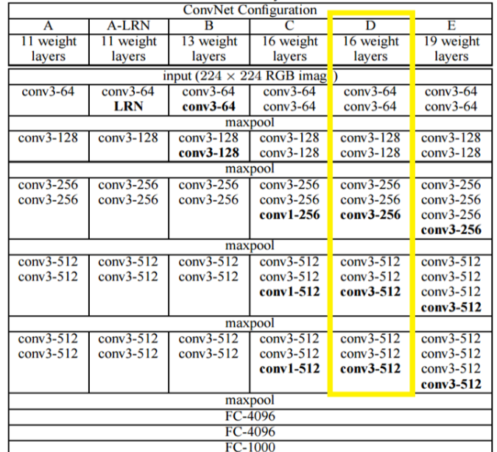
Ensembles in VGG
VGG16
VGG19
Reduces Overfitting, Improves Accuracy

Slide 35
Summary - VGG (2014)
Deeper architecture
Use of only 3x3 filters
Increasing filters with depth (Build more features)
Using Ensembles to improve results
Top-5 error rate 7.3%

Slide 36
Moving away from ‘Simple’

Slide 37
GoogLeNet
Input
Conv
Pool
Conv
Conv
Pool
1. Inception
2. Inception
3. Inception
4. Inception
5. Inception
6. Inception
7. Inception
8. Inception
9. Inception
Avg Pool
FC
SoftMax
Stacked Inception modules
9 Inception Modules
No FC Layer except last one
Error rate of 6.7%

Slide 38
Convolution OR Pooling?
What Size Convolution?

Slide 39
Using all the options
Concatenation
1x1 Conv
3x3 Conv
5x5 Conv
3x3 Max Pool
Previous Layer
Naive Inception module

Slide 40
But it does not work :(

Slide 41
Naive Inception Module
28x28x(128+192+96+256)
=28x28x672
Depth-wise Concatenation
Number of Ops:
1x1 Conv : 28x28x128x1x1x256
3x3 Conv : 28x28x192x3x3x256
28x28x128
28x28x192
28x28x96
28x28x256
128 1x1 Conv
S: 1, P:0
192 3x3 Conv
S:1, P:1
96 5x5 Conv
S:1, P:2
3x3 MaxPool, S:1, P:1
5x5 Conv : 28x28x96x5x5x256
Total: 854M
28x28x256
Input
Computationally very very complex

Slide 42
Power of 1x1 Convolution

Slide 43
28x28x256
28x28x32
1x1 Conv with 32 filters
Reduces depth

Slide 44
Efficient Inception Module
Concatenation
3x3 Conv
5x5 Conv
1x1 Conv
1x1 Conv
1x1 Conv
1x1 Conv
3x3 Max Pool
Previous Layer

Slide 45
Efficient Inception Module
28x28x480
Number of Ops:
Depth-wise Concatenation
1x1 Conv : 28x28x128x1x1x256
1x1 Conv : 28x28x64x1x1x256
1x1 Conv : 28x28x64x1x1x256
3x3 Conv : 28x28x192x3x3x64
5x5 Conv : 28x28x96x5x5x64
1x1 Conv : 28x28x64x1x1x256
28x28x192
28x28x96
28x28x64
192 3x3 Conv
96 5x5 Conv
64 1x1 Conv
28x28x128
128 1x1 Conv
28x28x64
28x28x64
28x28x256
Total: 358M
64 1x1 Conv
64 1x1 Conv
3x3 MaxPool
28x28x256
Input

Slide 46
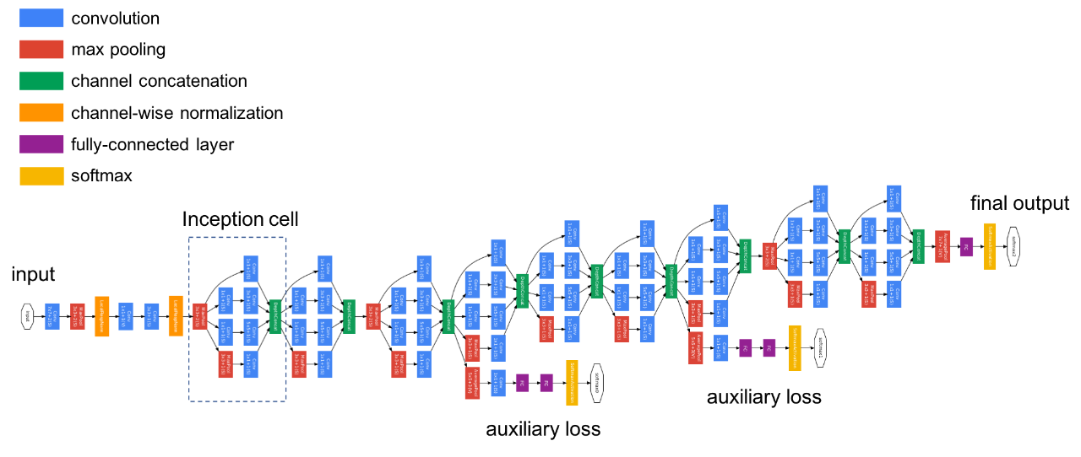
GoogLeNet Architecture

Slide 47
Auxiliary Loss
Calculate Loss for earlier Layers
Combine Auxiliary Loss with Final Loss
Why have Auxiliary loss?
Reduce Vanishing Gradient for earlier layers

Slide 48
No Fully Connected Layer
Conv
7 x 7 x 1024
Conv
7 x 7 x 1024
Earlier Network approaches
GoogLeNet approach
FC Layer
1024
Global Average Pooling
1024
1 x 1 x 1024
How many Weights?

Slide 49
No Fully Connected Layer
Conv
7 x 7 x 1024
Conv
7 x 7 x 1024
Earlier Network approaches
GoogLeNet approach
FC Layer
1024
Global Average Pooling
7 x 7 x 1024 x 1024 = 50M
0
Reduces Model size significantly

Slide 50
Summary - GoogLeNet (2014)
Use of Inception Module
1 x 1 Convolution
Auxiliary Loss
Avoid FC Layers to reduce Size
Global Average Pooling

Slide 51
Best practices so far . . .
Alexnet
Deep networks
Dropout
ReLU
Image Augmentation
Inference Augmentation
ZFNet
More filters
Smaller size filters

Slide 52
Best practices so far . . .
VGG
Deeper networks
Use 3x3 filters
Reduce height and width as we progress through deeper layers
Increase number of filters as we go through deeper layers
GoogleNet
Inception Module → Build features at different scale (3x3, 5x5) in parallel
Batch Normalization
Global Average Pooling

Slide 53
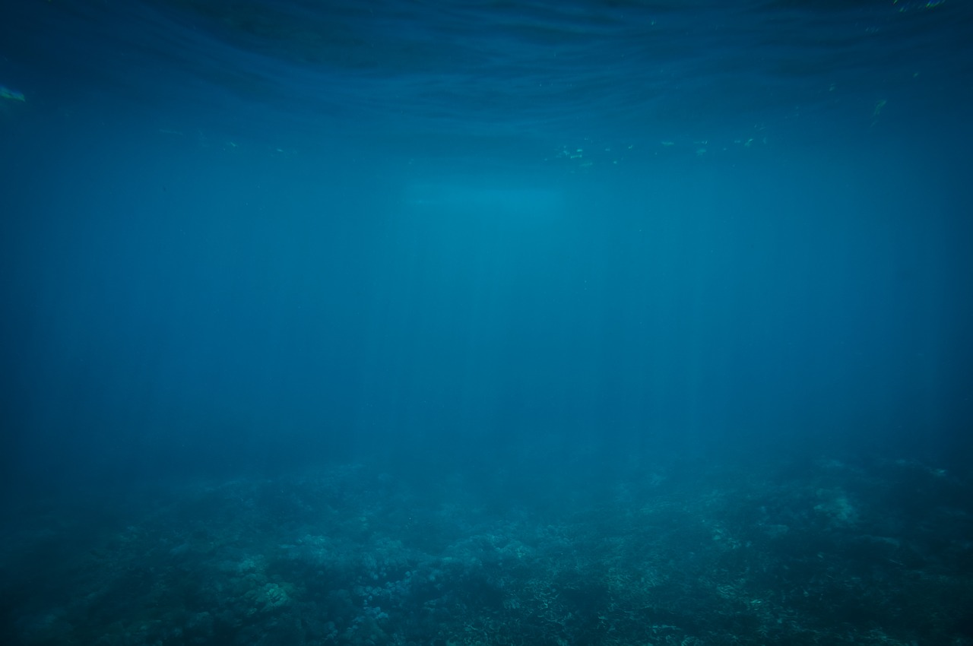
How deep can we really go?

Slide 54
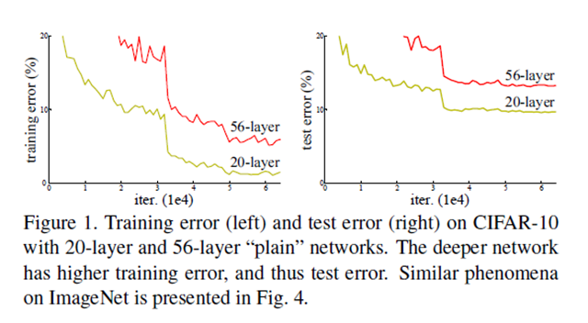
Accuracy saturates and then degrades
… due to vanishing gradients for earlier layers in the network

Slide 55
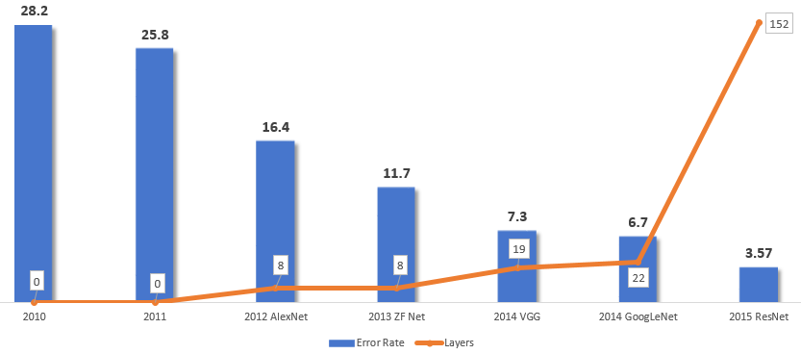
ILSVRC Winners
Deeper Networks
Deep?

Slide 56
ResNet
SoftMax
FC 1000
Pool
Ultra deep : 152 Layers
Residual blocks
Error Rate 3.7%
8 GPUs , 2-3 Weeks
3x3 Conv 64
3x3 Conv 64
Conv 128 3x3
Conv 128 3x3
Conv 128 3x3
Conv 128 3x3
Pool
Conv 64 7x7
Input

Slide 57
Residual Block
relu
H(X)
F(X) + X
+
Conv
Conv
X
relu
relu
Conv
Conv
X
X
Regular Stacking
Residual Block

Slide 58
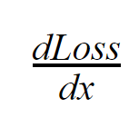
Normal Block
Loss
y_
y
?
Actual Labels
Conv
R₁
relu
C₁
Conv
X

Slide 59
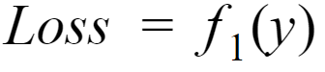
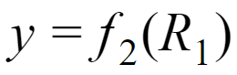
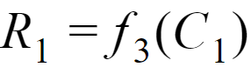
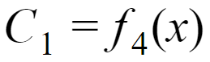
Normal Block
Loss
y_
y
Actual Labels
Conv
R₁
relu
C₁
Conv
How is Loss related to x?
X

Slide 60
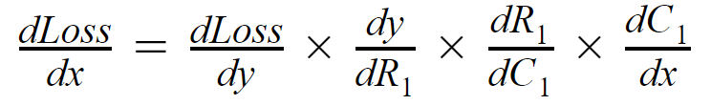
Normal Block
Loss
y_
y
Actual Labels
Conv
R₁
Gradient of Loss wrt ‘x’ based on chain rule
relu
C₁
Conv
X

Slide 61
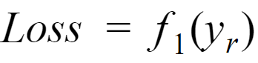
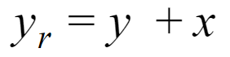
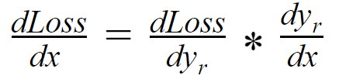
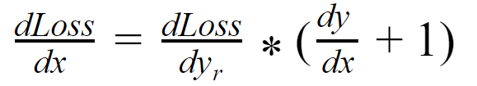
Residual Block
What will be gradient of Loss wrt ‘x’ in this case, will it improve?
Loss
y_
y_{r}
Actual Labels
+
y
Conv
R₁
X
relu
C₁
Conv
X
Same as regular block
Additional Gradient with Residual Block

Slide 62
ResNet (2015)
1st Place in ILSVRC 2015
1st Place in COCO Detection & Segmentation
Replacing VGG-16 with ResNet 101 in Faster-RCNN improved results by 28%
Efficiently trained networks with 100 layers and 1000 layers

Slide 63
Summary - ResNet (2015)
Residual Blocks with Skip connection → Reduces Vanishing Gradient problem!!!
Only Batch Normalization, No Dropout

Slide 64
Deep CNNs require lots of Data

Slide 65
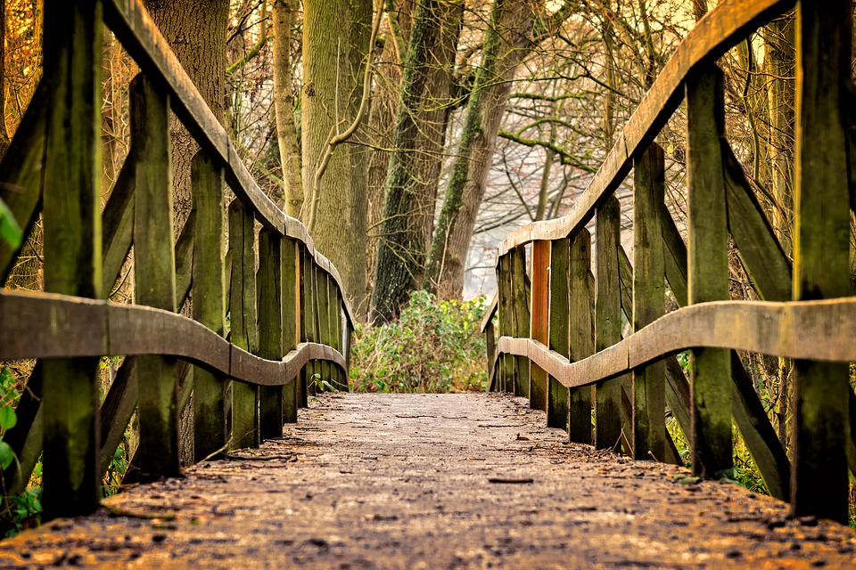
Transfer Learning

